Slide 1




Internal Task Management
System
Work Breakdown Structure & Effort Estimation

Slide 2
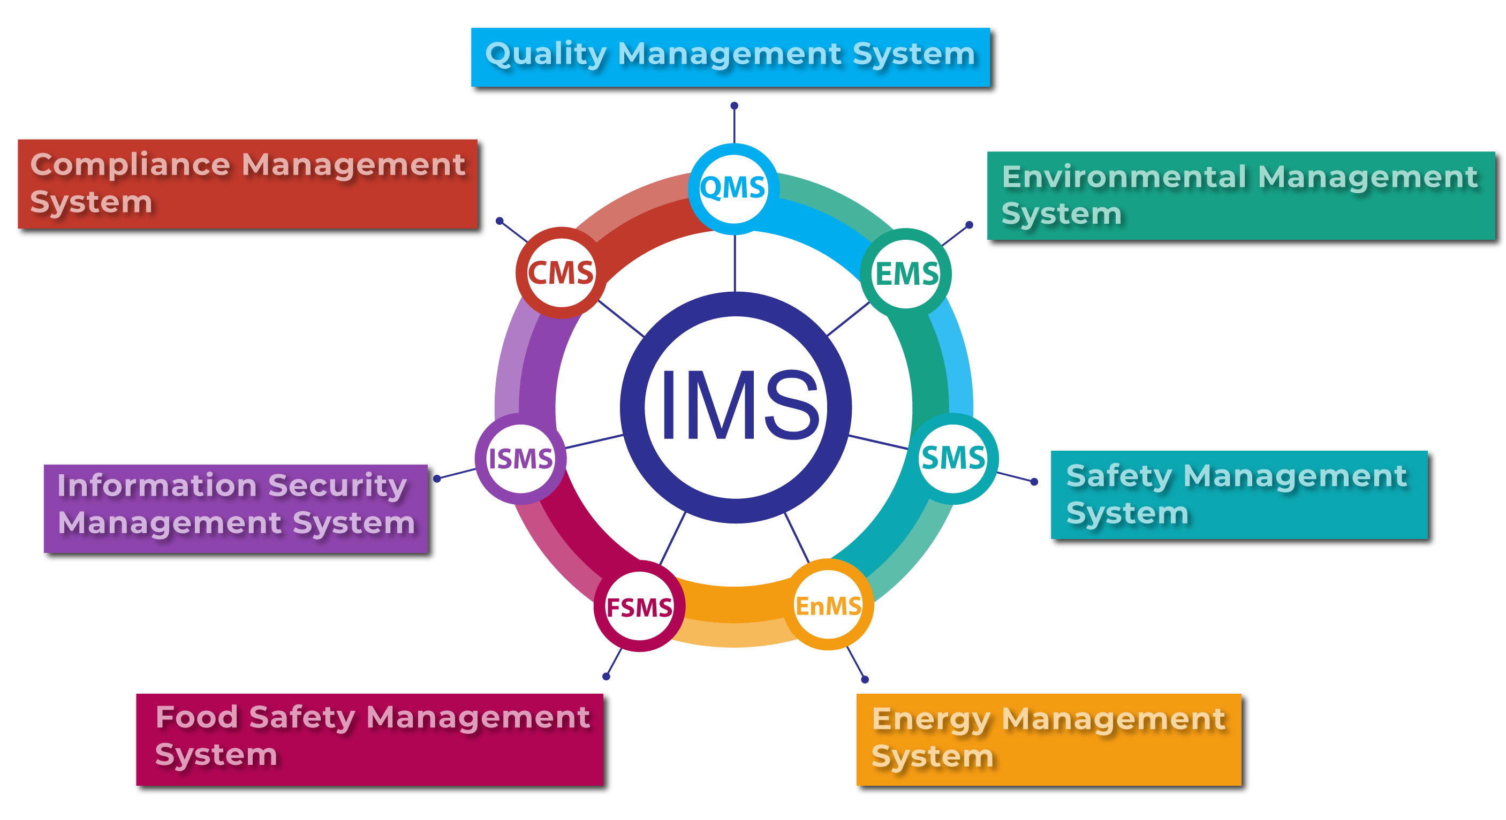

Slide 3
Project Overview
Background
Internal tasks are currently managed through spreadsheets and chat messages.
Task tracking and visibility are difficult.
Overdue tasks are hard to identify.
Business Objective
Centralized task management.
Improved team visibility.
Better productivity and accountability.

Slide 4
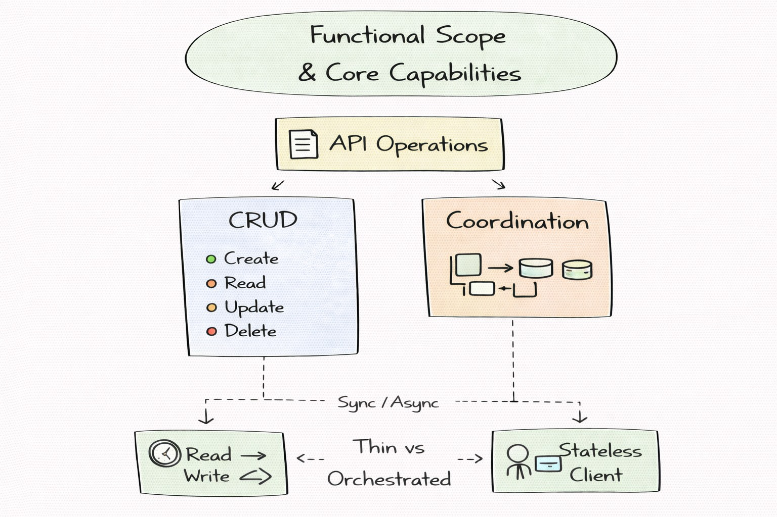
Functional Scope
- User Management
- Task Management
- Tracking & Reporting

Slide 5
Proposed Solution
Component | Technology
Backend | Django
Database | PostgreSQL
Frontend | HTML/CSS + Django Templates
Authentication | Django Authentication
Version Control | Git

Slide 6
Work Breakdown Structure
1.Project Planning
2. System Design
3. Database Design
4. Backend Development
5. Frontend Development
6. Testing
7. Documentation
8. Deployment
9. Project Closure

Slide 7
Effort Estimates
Planning | 10 | 1.25
Design | 14 | 1.75
Database | 16 | 2
Backend | 46 | 5.75
Frontend | 20 | 2.5
Testing | 24 | 3
Documentation | 6 | 0.75
Deployment | 8 | 1
Closure | 4 | 0.50
Total | 148 | 17.76

Slide 8

Assumptions & Dependencies

Slide 9
Risks & Ambiguities
Risks
Requirement changes during development
Authentication issues
Testing delays
Deployment issues
Ambiguities
User registration process
Task visibility permissions
Notification requirements
Task deletion vs archiving

Slide 10
THANK YOU FOR THE ATTENTION

